Slide 1
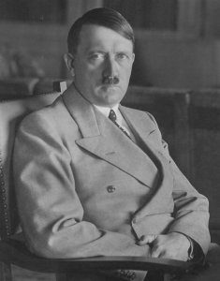
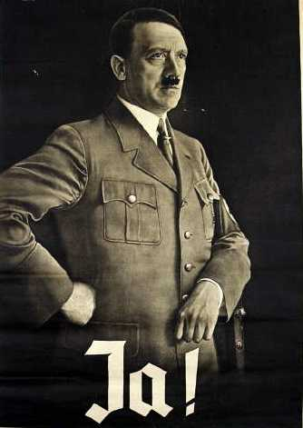
The Power of Nazism

Slide 2
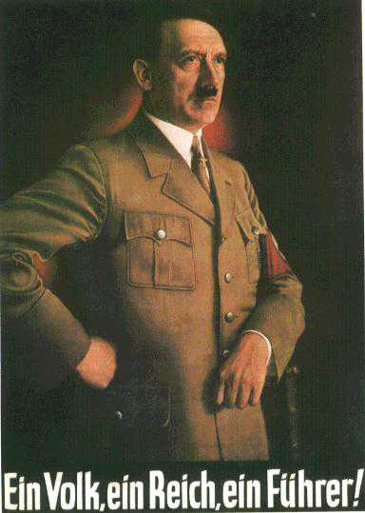

Slide 3

The Eternal Jew

Slide 4
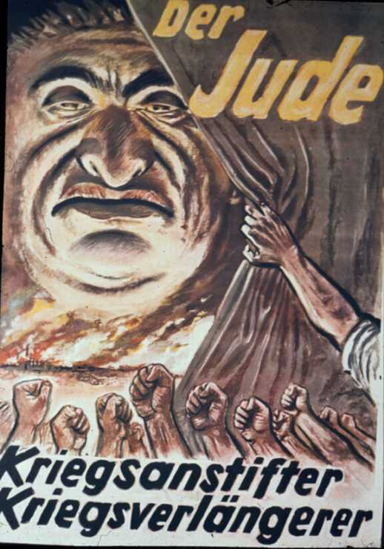
"The Jew: The inciter of war, the prolonger of war."

Slide 5
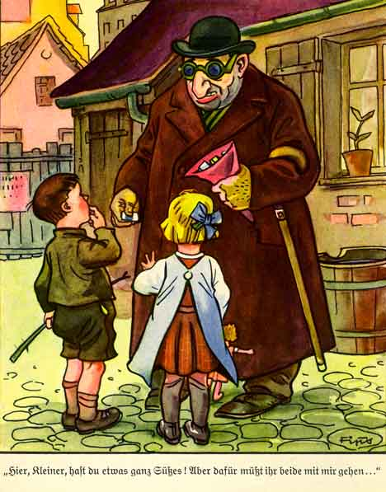
The Experience of Hans and Else with a Strange Man :
"Here, kids, I have some candy for you. But you both have to come with me..."

Slide 6
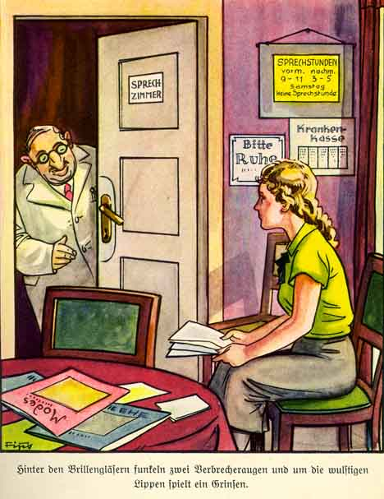
Inge's Visit to a Jewish Doctor :
"Two criminal eyes flashed behind the glasses and the fat lips grinned."

Slide 7
"My program for educating youth is hard. Weakness must be hammered away. In my castles of the Teutonic Order a youth will grow up before which the world will tremble. I want a brutal, domineering, fearless, cruel youth. Youth must be all that. It must bear pain. There must be nothing weak and gentle about it. The free, splendid beast of prey must once again flash from its eyes...That is how I will eradicate thousands of years of human domestication...That is how I will create the New Order." (Adolf Hitler, 1933)

Slide 8
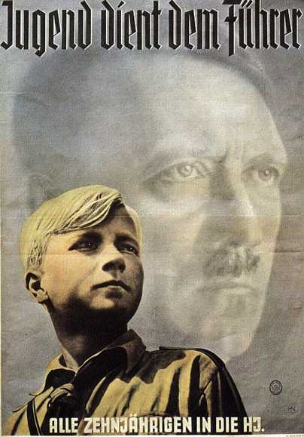
The text of this 1940 poster reads: "Youth Serves the Führer. All 10-year-olds into the Hitler Youth." Membership in the Hitler Youth had become mandatory in 1936.

Slide 9
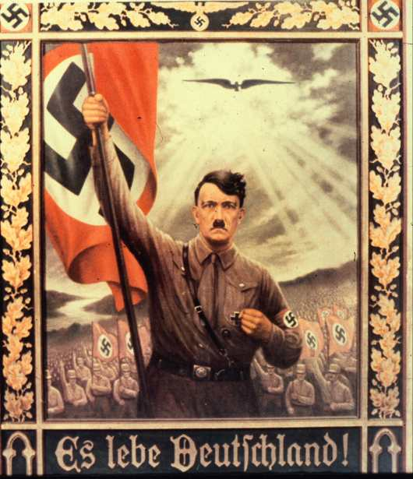
This poster makes a direct religious comparison. Just as a dove descended on Christ when he was baptised by John the Baptist, so what looks to be an eagle hovers against the light of heaven over an idealized Hitler. The text: "Long live Germany!."

